Slide 1

CORPORATE
PRESENTATION

Slide 2

ATS HomeKraft
A part of ATS Group,
With HDFC Capital as Equity Partner.
Garnered significant impression in the real estate sector,
With a new concept in the realm of aspirational housing.
Legacy of Over
Designed Over
In Progress Over
21
50
40
Years
M Sq.Ft.
M Sq.Ft.

Slide 3
TIMELINE
Formation of HomeKraft
Launched Pious Hideaways
Launched Floral Pathways
Launched Bonheur Avenue (Ph 1)
Launched GROW+ (Nobility)
2017
2018
2019
2019
2021
2021
2022
2022
2022
Launched Happy Trails
Launched Nobility
Launched Pious Orchards
Launched GROW+
(Happy Trails)
PLANNED DELIVERIES:
Nobility, Bonheur Avenue, Pious Hideaways, Jeevan Sukh, Khyber Range
Launched Bonheur Avenue (Ph 2)
2024
2023
2023
2023
PLANNED PROJECTS:
Launched GROW+ (Bonheur Avenue)
Delivered Happy Trails
Kabana High, 1000 Trees, Grandstand, Golf Meadows Lifestyle

Slide 4
PROJECT STATUS
RESIDENTIAL

Slide 5
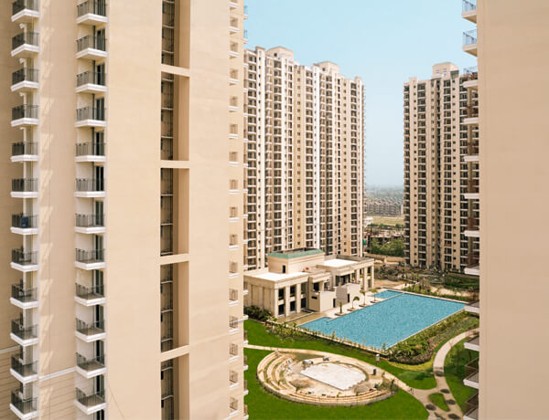
DELIVERED
HAPPY TRAILS
Sector 10,
Greater Noida West
Launched in APR’18,
Spread across 9 Acres,
1239 Apartments,
Typology: 2 BHK + Study & 3 BHK + Study,
Size: 1165 & 1625 Sq. Ft.
900+ FAMILIES RESIDING

Slide 6
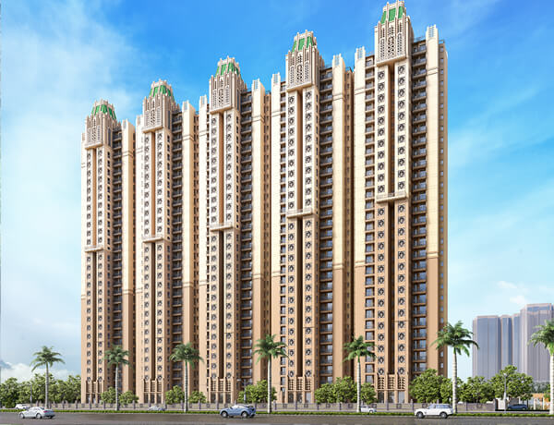
READY FOR POSSESSION
NOBILITY
Sector 4,
Greater Noida West
Launched in AUG’19,
Spread across 5 Acres,
604 Apartments,
Typology: 3 BHK + Study,
Size: 1675 Sq. Ft.
Delivery started in MAY’24,
100% SOLD OUT

Slide 7
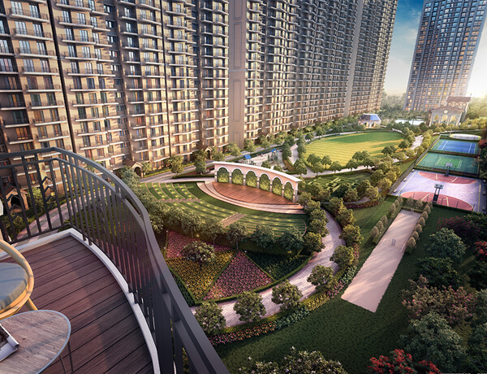
READY FOR POSSESSION
PIOUS HIDEAWAYS
Sector 150,
Greater Noida
Launched in APR’19,
Spread across 9 Acres,
749 Apartments,
Typology: 3 BHK + Study,
Size: 1450 & 1675 Sq. Ft.
Delivery started in JUN’24,
97% SOLD OUT

Slide 8
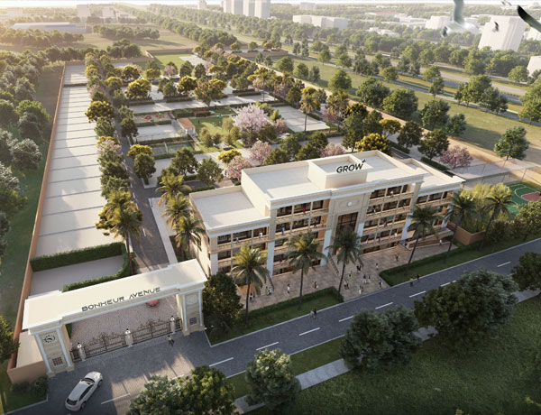
READY FOR POSSESSION
BONHEUR AVENUE
(Phase 1)
Sector 35, Gurugram
Launched in OCT’22,
Spread across 5 Acres,
140 Plots,
Size: 140 – 167 Sq.Yds.
OC APPLIED
100% SOLD OUT

Slide 9
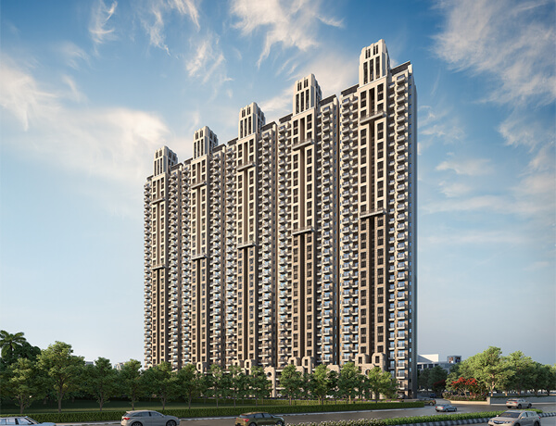
UNDER CONSTRUCTION
FLORAL PATHWAYS
NH 24,
Ghaziabad
Launched in AUG’21,
Spread across 5 Acres,
696 Apartments,
Typology: 3 BHK + Study,
Size: 1720 Sq.Ft.
90% SOLD OUT

Slide 10
UNDER CONSTRUCTION
PIOUS ORCHARDS
Sector 150,
Greater Noida
Launched in OCT’21,
Spread across 9 Acres,
608 Apartments,
Typology: 3 BHK + Study & 5 BHK + Servant,
Size: 2350 & 3200 Sq.Ft.
80% SOLD OUT

Slide 11
UNDER CONSTRUCTION
BONHEUR AVENUE
(Phase 2)
Sector 35, Gurugram
Launched in APR’23,
Spread across 5 Acres,
87 Plots
Size: 140 – 167 Sq.Yds.
95% SOLD OUT

Slide 12
PROJECTS STATUS
COMMERCIAL

Slide 13
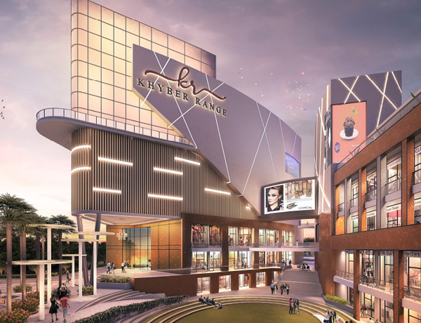
UNDER CONSTRUCTION
KHYBER RANGE
NH 24,
Ghaziabad
Launched in 2019,
Spread across 3 Acres,
305 Units,
High Street Complex,
Size varies from 277 – 2000 Sq.Ft.
90% SOLD OUT

Slide 14

UNDER CONSTRUCTION
HAPPY TRAILS
NOBILITY
BONHEUR AVENUE
Launched in 2022,
41 Units,
High Street Complex,
Size starting from 72 – 580 Sq.Ft.
Launched in 2022,
20 Units,
High Street Complex,
Average Size of 407 Sq.Ft.
Launched in 2023,
48 Units,
High Street Complex,
Average Size of 890 Sq.Ft.
100% SOLD OUT
100% SOLD OUT
100% SOLD OUT

Slide 15
UPCOMING PROJECTS
RESIDENTIAL & COMMERCIAL

Slide 16
GOLF MEADOWS LIFESTYLE
GRANDSTAND
1000 TREES
KABANA HIGH
DERA
BASSI
Sector 99, Gurugram
Sector 105, DXP, GURUGRAM
Sector 4, Greater Noida west
Upcoming Projects
In FY 2024-25

Slide 17
AWARDS & ACCOLADES
IN LAST 2 YEARS

Slide 18










& Many More…

Slide 19
THANK YOU

